Slide 1
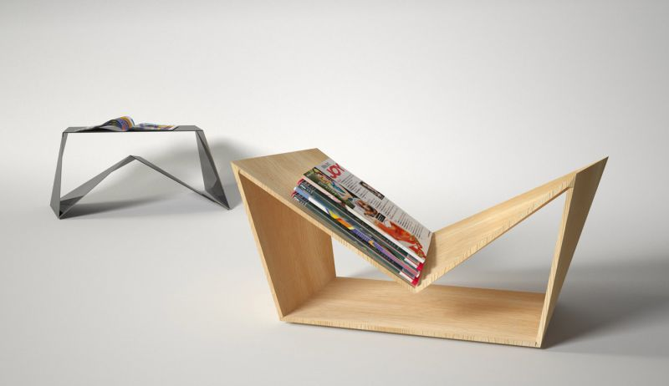
higher Design & Manufacture
Research Methods

Slide 2
Learning intentions & success criteria
Learning Intentions
Develop our to interpret a brief and apply our skills in research to inform a design specification.
Success Criteria
I can understand how to analyse a design brief.
I can apply my research skills to create an informed decision.
I can use my informed decisions to justify my design specification.

Slide 3
research types of research
There are two different types of research
Primary Research
This is when you have to do all the work yourself as the designer.
Secondary Research
This is the easier type of research as it requires you to use the results of others research.

Slide 4
research primary research
Making direct contact with recognised experts and interviewing them
Doing some form of field work
Keeping in contact with the client
Testing models and other similar commercially available products
Visiting exhibitions, displays, and trade shows to collect information
Producing questionnaires and carrying out surveys
Modelling and conducting computer simulations and analysing the results

Slide 5
research secondary research
Reading articles from books, magazines and journals
Accessing the internet
Collecting product literature produced by the manufacturer/designer
Reading handout sheets, data sheets, consumer reports

Slide 6
Types of research field research
EXPERIMENTS, such as demonstrating a new product in a store after its launch or conducting tests on product in class
AUDITS, carrying out a check of product stocks in shops and stores
OBSERVING, such as noting how many people use a public telephone over a period
RECORDING, counting how often consumers use a specific product over a set time
SURVEYS, interaction with a specified market group through questionnaires, individual interviews and group interviews

Slide 7
Types of research desk research
EXTERNAL SOURCES
Reports, newspapers, journals, media reports, government audits
INTERNAL SOURCES
Accounts, sales records But NOTE:
Desk research may not always provide the most up-to-date information.
The fact that the source has already been published may mean that current trends or new competition to the product have not been taken into account.
However, it may well provide general information about consumers and competitors.
It is much cheaper and quicker to undertake than field research because the information has already been recorded.
For this reason it is normally undertaken first.

Slide 8
Establishing a target market
Before you begin field research you need to identify your target market
How are the people in the survey to be chosen?
Who is to be surveyed?
How many people should be surveyed?

Slide 9
Designing a survey
Use different types of questions
Make sure that you find out ages and sex of participant for your analysis
Ensure that the survey is easy to read and quick to complete
Have a wider cross section for your survey than the class – friends/family/other teachers/work colleagues/ etc
Use paper or use survey monkey.

Slide 10
Different types of questions
CLOSED QUESTIONS
These normally result in a yes/no answer. Although these are useful it does not allow you to gather much information
OPEN QUESTIONS
This type of question is designed to encourage people to give their opinion. This type of question can be difficult to answer and should be phrased carefully to avoid the risk of influencing answers
RATINGS QUESTIONS
This type of question can help people express an opinion and is quicker and easier method. Normally give users a predetermined scale to select a score from
STRUCTURED QUESTIONS
These are used if more complex answers are required or if different answers then require different follow on questions.

Slide 11
Focus group
As a designer you will be designing a product for your client. You need to carry out research on your target market to allow you to design for the right group(s) of people.
Focus groups can be carried out to allow you to ask questions about your ideas and get accurate feedback.
Focus groups could discuss an existing product to allow you, as a designer, to develop an existing product to make it more successful.

